Slide 1

Hazwan’s Loan Prediction App

Slide 2
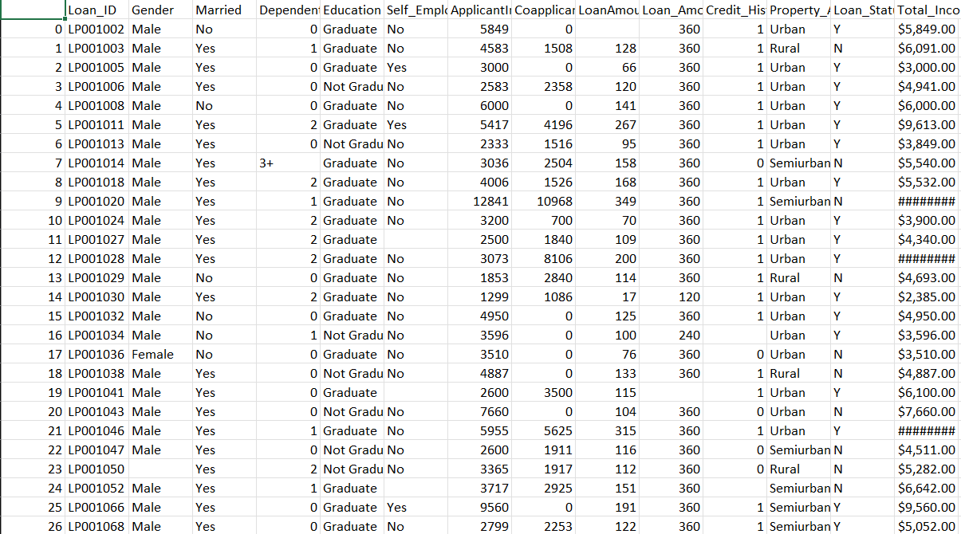
The dataset:
-holds data about applicants
-has some unnecessary data
-requires cleaning
-save the important details
And identifying the goal

Slide 3
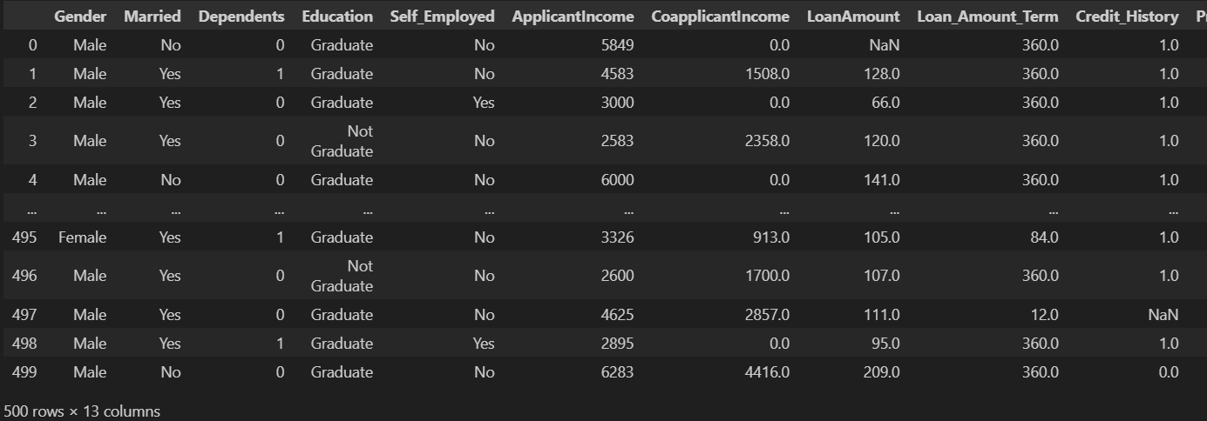
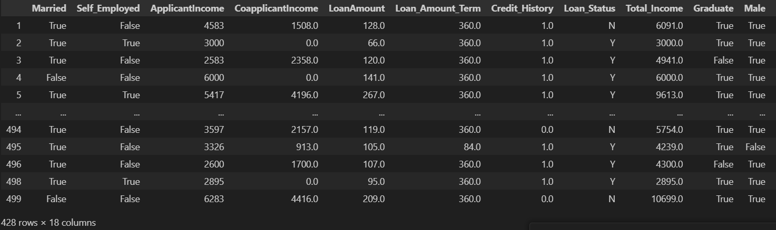
Cleaning:
The data before and after cleaning

Slide 4
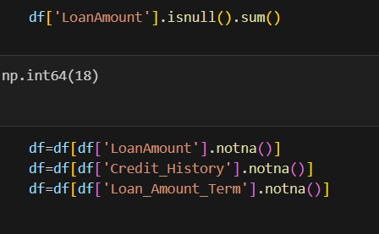
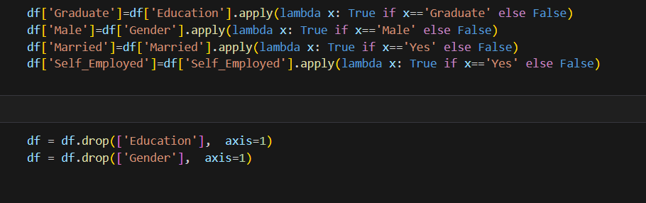
What was done:
Converting categorical string data to Booleans:
Removing of null data

Slide 5
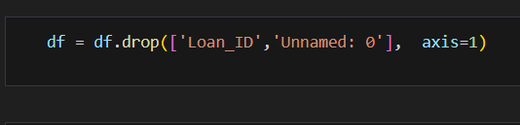

Dropping unnecessary data and OHE

Slide 6

The one I chose: RandomForestClassifier
Why?
Better hypertuning result
Good balance with the classification score
Data enter in the model is accurate when compared to original dataset in comparison to approve and rejection
The ones I skipped: Randomforestclassifier
LineardescriminantAnalysis
LogisticRegression
DecisisonTreeClassifier
KneighbourClassifier,Gausian NB,SVM

Slide 7
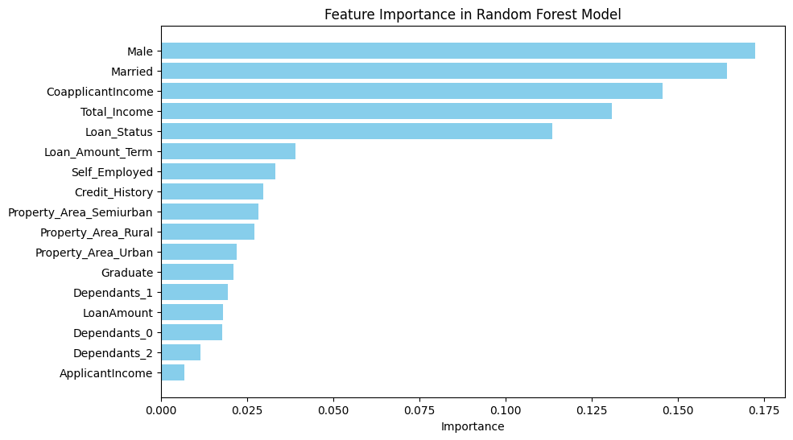
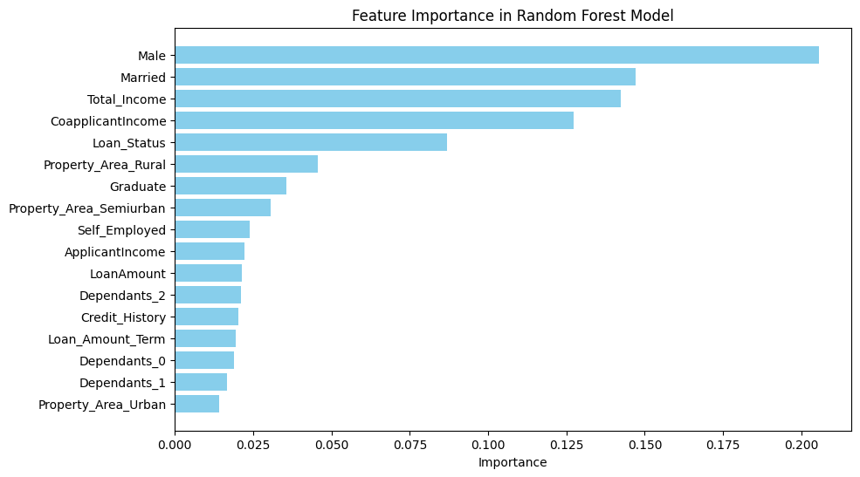
But is this dataset perfect?
To test this, I checked what was the most influential feature
Using the feature importance graph
The first feature importance for gender: 0.1933
The model after
The testing feature importance for gender is : 0.1725

Slide 8
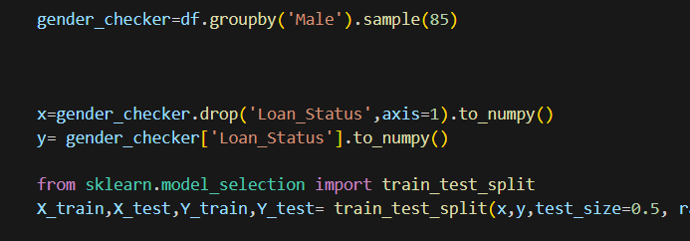
Testing this hypothesis
Creating a testing dataset

Slide 9




Still a difference?
Before
After

Slide 10
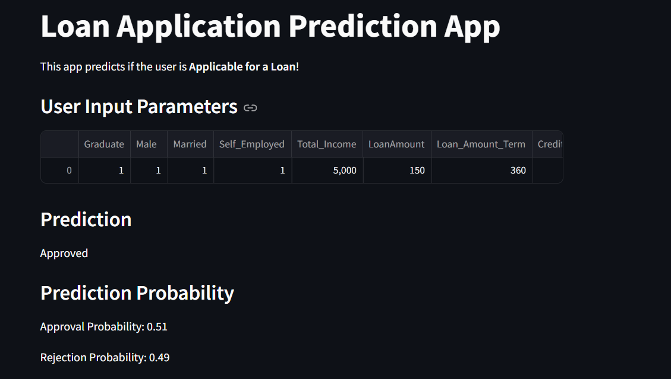
My site/app
http://localhost:8501/

